Slide 1
Threads
Instructor: William Zheng
Email: william.zheng@digipen.edu
PHONE EXT: 1745
Notes:
1

Slide 2
Lecture Outline
Review on stack
Intro to Multithreading
Multithreading Models
Multithreading APIs
Notes:
2

Slide 3
Stack Pointer and Program Counter
high
addresses
Consider a code with the following
functions:
int main(int argc,
char**argv);
char *foo(int, int, int);
int goo(double, int);
Assume that the functions are called:
main->foo->goo
PC pointing to main
Stack is empty
code
stack + heap
SP
main
PC
foo
goo
low
Notes:
3

Slide 4
Stack Frame
Register
save
area
high
addresses
code
stack + heap
main
main SF
Local
Variables
SP
PC
foo
goo
Function Parameters
old PC
low
old SP
SP
Notes:
4

Slide 5
Stack Frame Organization - I
Register
save
area
char *foo(int x, int y , int z)
{
int a;
char array[500];
double d;
…
a = x+y+goo(d,z);
…
}
Local
Variables
Function Parameters
old PC
SP
old SP
Notes:
5

Slide 6
Stack Frame Organization - II
Register
save
area
char *foo(int x, int y , int z)
{
int a;
char array[500];
double d;
…
a = x+y+goo(d,z);
…
}
Local
Variables
Function Parameters
old PC
SP
old SP
Notes:
6

Slide 7
Stack Frame Organization - III
Register
save
area
char *foo(int x, int y , int z)
{
int a;
char array[500];
double d;
…
a = x+y+goo(d,z);
…
}
Local
Variables
Function Parameters
old PC
SP
old SP
Notes:
7

Slide 8
Stack Frame Organization - IV
Register
save
area
char *foo(int x, int y , int z)
{
int a;
char array[500];
double d;
…
a = x+y+goo(d,z);
…
}
Local
Variables
Function Parameters
old PC
SP
old SP
Notes:
8

Slide 9
Function Call and SF Creation - I
high
addresses
Push variables
code
stack + heap
main
main SF
PC
Foo’s Args
SP
foo
goo
low
Notes:
9

Slide 10
Function Call and SF Creation - II
high
addresses
Push variables
Call foo
code
stack + heap
main
main SF
Foo’s Args
foo
SP
main PC
PC
goo
low
Notes:
10

Slide 11
Function Call and SF Creation -III
high
addresses
Push variables
Call foo
Save main SP and decrement SP
code
stack + heap
main
main SF
Foo’s Args
foo
main PC
foo SF
PC
SP
goo
low
Notes:
11

Slide 12
Function Call and SF Creation -IV
high
addresses
Push variables
Call foo
Save main SP and decrement SP
code
stack + heap
main
main SF
Foo’s Args
foo
main PC
foo SF
PC
SP
goo
Done in software
i.e., done by instructions
generated by the compiler!
low
Notes:
12

Slide 13
Q & A
Does each function use the same stack frame size?
No. Depends on the size of local variables
How and when is the size of stack frame determined?
Compiler determines by looking at the code. Compile-time.
How is the stack frame allocated during run-time?
Decrementing the stack pointer
Notes:
13

Slide 14
Q & A
What is the stack pointer?
A value stored in stack pointer register (%esp) pointing to the beginning of the stack frame
What is a program counter?
A value stored in program counter register (%eip) pointing to a point in the text
Notes:
14

Slide 15
Single-thread process
high
addresses
Thread of control
PC
SP
Stack
code
stack + heap
main
main SF
Foo’s Args
foo
main PC
foo SF
PC
SP
goo
low
Notes:
15

Slide 16
Multi-threaded process
high
addresses
code
stack
stack
stack
main
main SF
foo SF
foo SF
SP₂
SP₃
foo’s Args
goo’s Args
main PC
main PC
foo
foo SF
goo
SF
PC₂
PC₁
SP₁
goo
PC₃
low
Notes:
16

Slide 17
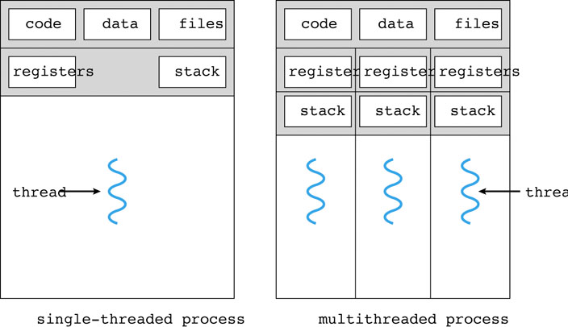
Multi-threaded versus single threaded
Notes:
17

Slide 18
Why Multithreading?
Responsiveness
Resource Sharing
Economy
Scalability
Notes:
18

Slide 19
Matrix multiplication
How many arithmetic operations ?
Notes:
19

Slide 20
An initial solution
void slow_multiply(Matrix A, Matrix B, Matrix C)
{
for(int i=0;i<m;i++)
{
for(int j=0; j<k; j++)
{
acc = 0;
for(int r=0; r<n; r++)
{
acc += A[i][r]*B[r][j];
}
C[i][j] = acc;
}
}
}
Notes:
20

Slide 21
Resources Usage
void slow_multiply(Matrix A, Matrix B, Matrix C)
{
…
}
void slow_multiply(Matrix A, Matrix B, Matrix C)
{
…
}
CPU₁
CPU₁
CPU₂
CPU₃
CPU_{n}
…
Notes:
21

Slide 22
Doing better
Instead of computing
Why don’t we …. split up the computation?
Notes:
22

Slide 23
Two kinds of stack
User Stack
Used for user-level programs
Kernel Stack
Used by system-calls
Notes:
23

Slide 24
Single thread execution
user
mode
execution
System call
kernel
mode
execution
Notes:
24

Slide 25
Multithreading Model
Ratio of User Level Threads to Kernel Level Threads in a Process
M : 1
1 : 1
M : N
Notes:
25

Slide 26
M : 1 Model
user
mode
execution
System call
kernel
mode
execution
Notes:
26

Slide 27
1:1 Thread Execution
user
mode
execution
System call
kernel
mode
execution
Notes:
27

Slide 28
M:N Thread Execution
user
mode
execution
System call
kernel
mode
execution
Notes:
28

Slide 29
Threads API
Basic
Thread Creation
Thread Joining & Exit
Advanced
ProcessorAffinity
Yield CPU
Notes:
29

Slide 30
Threads Creation
Thread ID
Passing Arguments to thread
Starting function for thread
pthread_create in Linux/Unix
CreateThread in Win32
Notes:
30

Slide 31
Threads Joining and Exit
Linux
pthread_join and pthread_exit
Win32
WaitForSingleObject
ExitThread
Notes:
31

Slide 32
thread_exit() vs exit()
Thread_exit() for a thread
Allocated resource not cleanup
Not cleanup system resources shared among threads
To allow other threads to continue execution, the main thread should terminate by calling pthread_exit()
Return – cleanup
Exit() for a task
Terminate a process when called by any thread
Thread_cancel()
Notes:
32

